Slide 1
Design Patterns
Joris Geurts
Marjo van Zundert

Slide 2
peer reviewing
what is it?
experiences?
why?

Slide 3
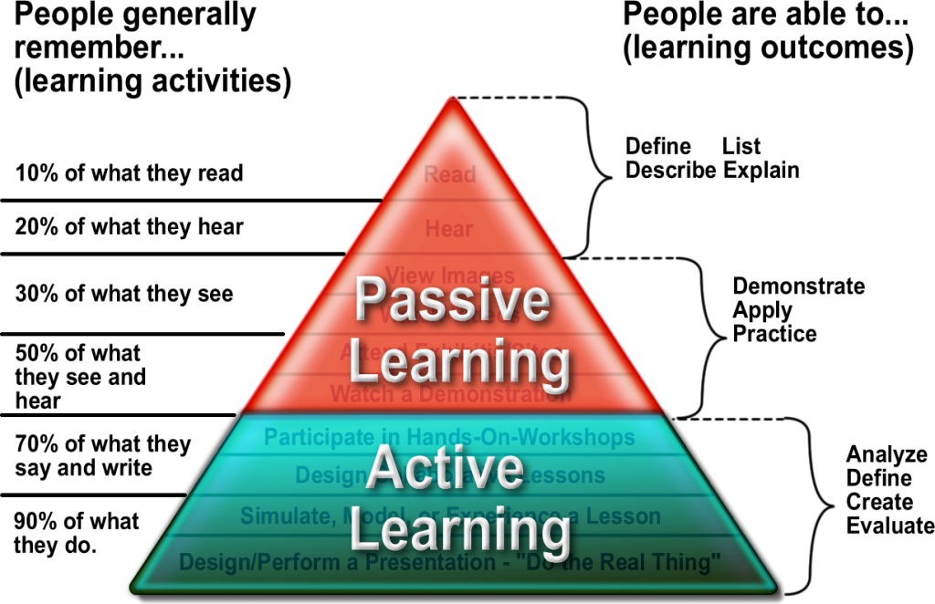
peer review & peer tutoring

Slide 4

how to do a review?
remember: design patterns = communication
feed back
what is OK? (compliments!)
what is not OK?
feed forward
what can you do to improve for a next time?
Be specific and to the point!
remember: design patterns = communication
feed back
what is OK? (compliments!)
what is not OK?
feed forward
what can you do to improve for a next time?
Be specific and to the point!

Slide 5
criteria (see wk 1)
handwritten UML with correct notation; all classes of application
implementation according to original pattern
proper names for methods and variables
application shows strength of pattern
program runs properly, easy to use, clear results; good coverage of the test cases
(bonus) new project with quality improvements

Slide 6
review Decorator
wk 16:
find a peer group
exchange submissions (dropbox, mail, …)
study other group's implementation
feed back
feed forward
give a mark (1-10)
discuss & explain with other group
add your review comments and mark to your documentation (for those who already handed their assignment in: please send it separately)

